Slide 1




BIG DATA
ANALYSIS FROM AMAZON
CUSTOMER FOOD’S REVIEWS
PRESENTATION BY GROUP 3
Nguyen Thi Huong (Rebecca)
Hans Tjandra (Hans)
Gregorius Gorat (Grego)
陳則銘 (Jimmy)
王奕翔(Anderson)
M11201836
M11415814
M11415817
M11407W01
M1145102

Slide 2
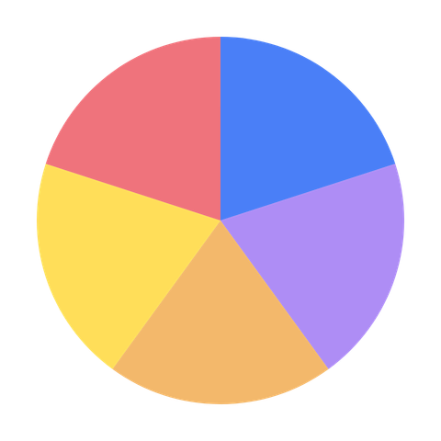


CONTRIBUTION
Data exploration, cleaning, and preprocessing for the Amazon review dataset. Led food safety and health hazard detection design and implementation.
DISTRIBUTION
Hans
Data exploration, cleaning, and preprocessing for the Amazon review dataset. Product Overview Analysis, final reporting/presentation flow.
Rebecca
Data exploration, cleaning, and preprocessing for the Amazon review dataset. Led NLP feature engineering, including word count, helpfulness, and weighting logic.
Grego
Data exploration, cleaning, and preprocessing for the Amazon review dataset. Led food safety and health hazard detection technical and labeling.
Anderson
Data exploration, cleaning, and preprocessing for the Amazon review dataset. Led NLP feature engineering, including word count, helpfulness, and weighting logic.
Jimmy

Slide 3




01
Problem Motivation & Objective
02
Data & Processing Setup
CONTENT OF PRESENTATION
03
Technical Design and Methodology
04
Results & Decision Value
05
Conclusion + Limitations + Future Work

Slide 4
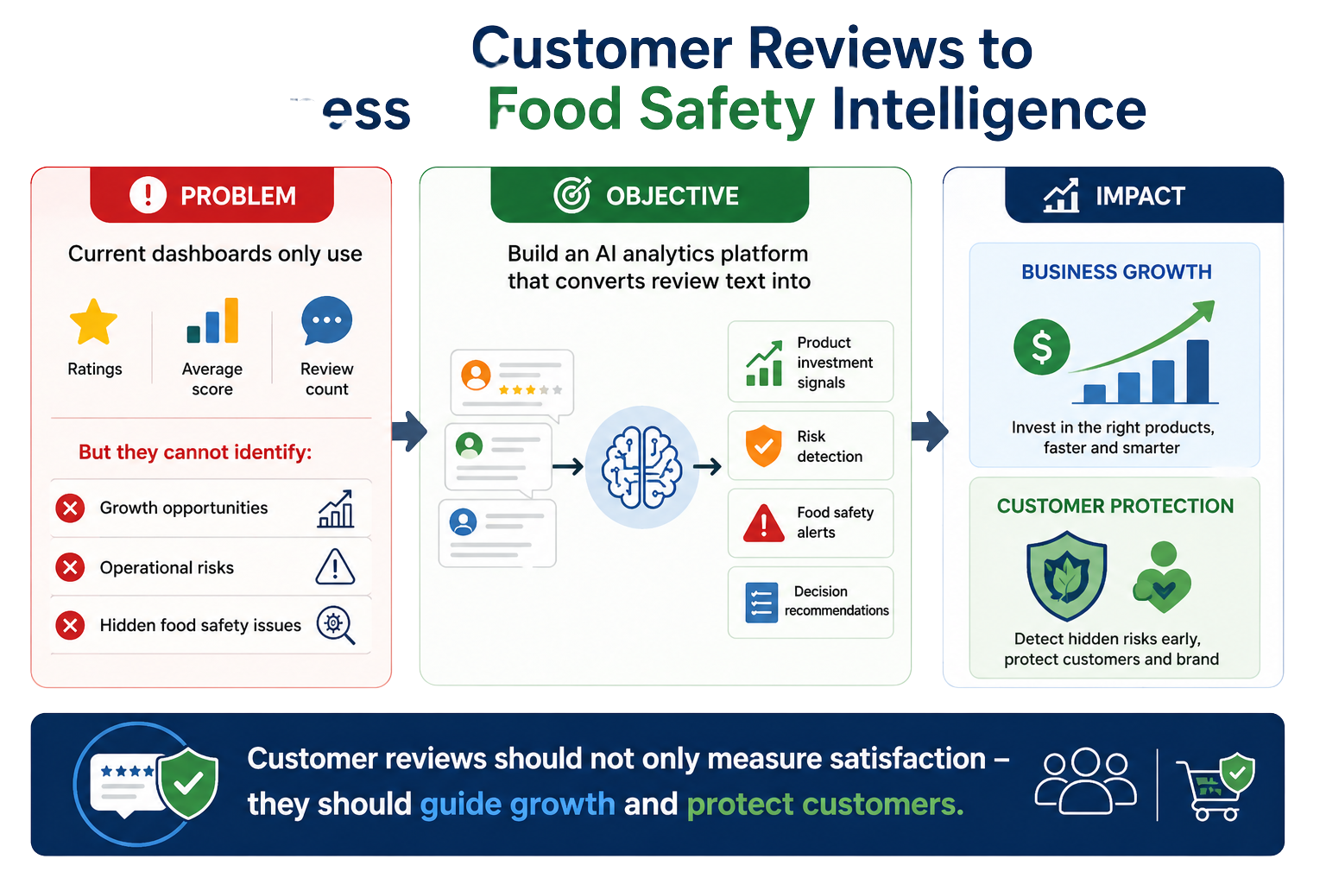

Problem and Objective
E-commerce platforms receive massive volumes of customer reviews every day, but most of this data is only used for simple performance tracking
Customer reviews should not only measure satisfaction - they should guide growth and protect customers

Slide 5
01
Problem Motivation & Objective
02
Data & Processing Setup
CONTENT OF PRESENTATION
03
Technical Design and Methodology
04
Results & Decision Value
05
Conclusion + Limitations + Future Work

Slide 6





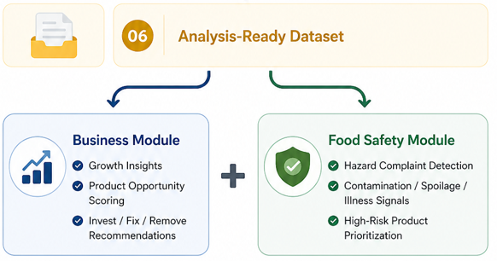
Data & Processing Setup

Slide 7
01
Problem Motivation & Objective
02
Data & Processing Setup
CONTENT OF PRESENTATION
03
Technical Design and Methodology
04
Results & Decision Value
05
Conclusion + Limitations + Future Work

Slide 8
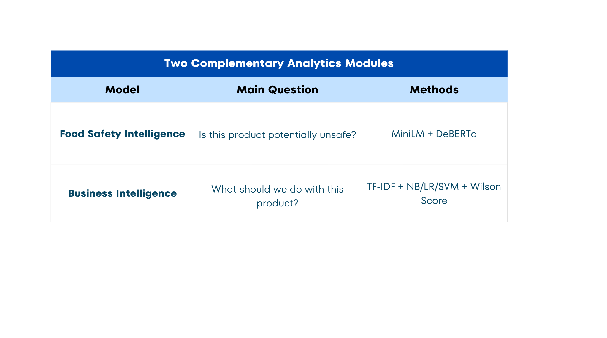
Model introducing
We developed two complementary modules.
The Food Safety Module uses MiniLM and DeBERTa to detect hidden hazard complaints.
The Business Decision Engine uses TF-IDF, classical ML models, aspect extraction, and Wilson credibility scoring to convert reviews into product-level business actions.

Slide 9
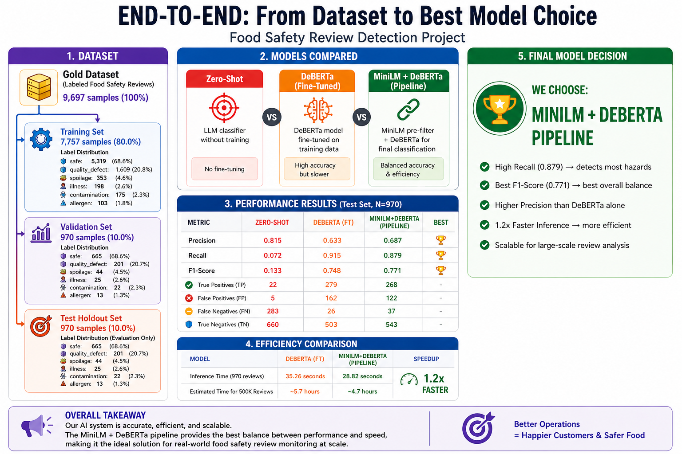
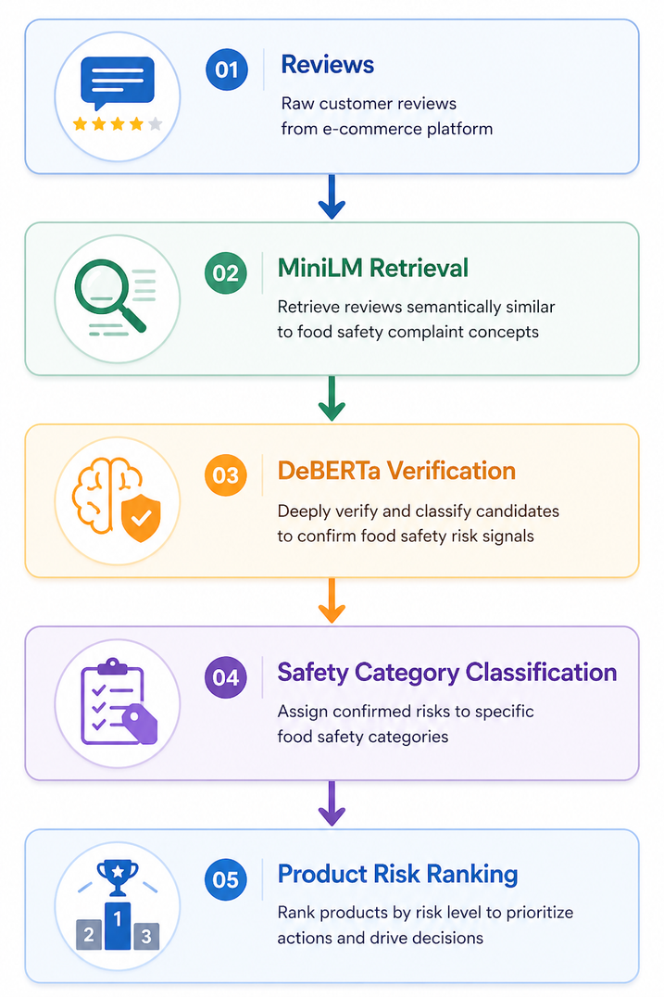
Food Safety Intelligence

Slide 10
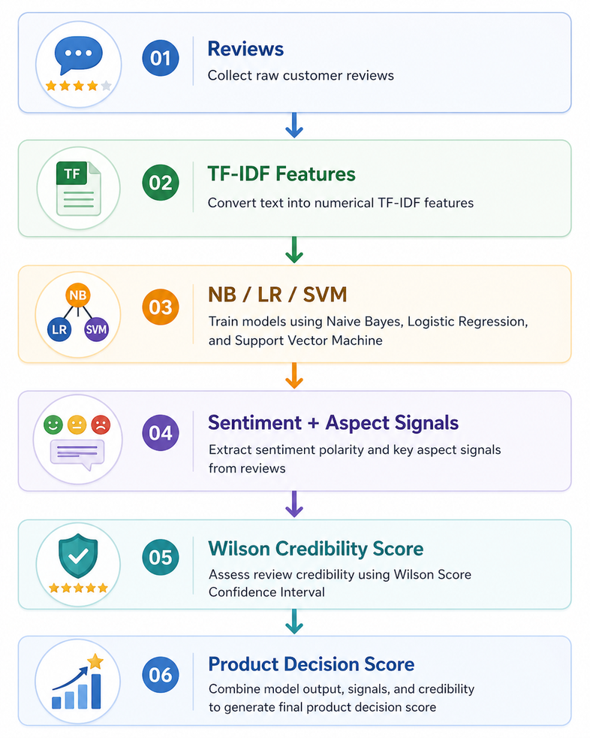
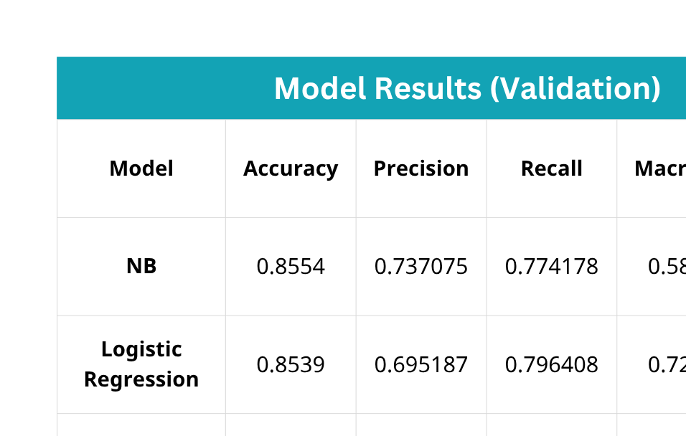
Business Intelligence

Slide 11
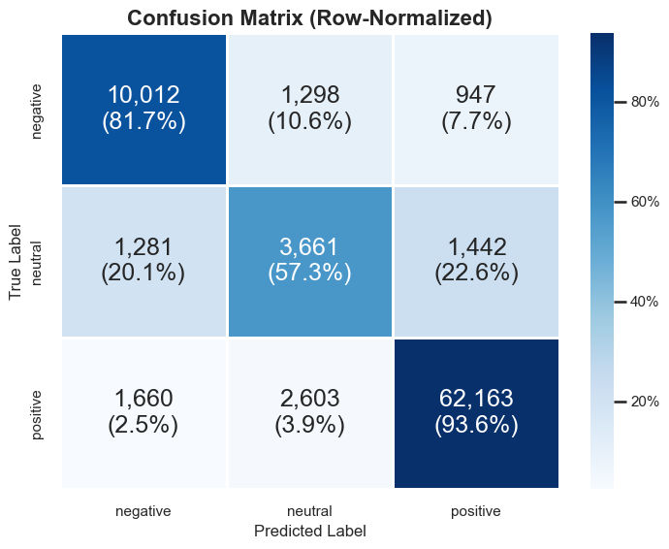
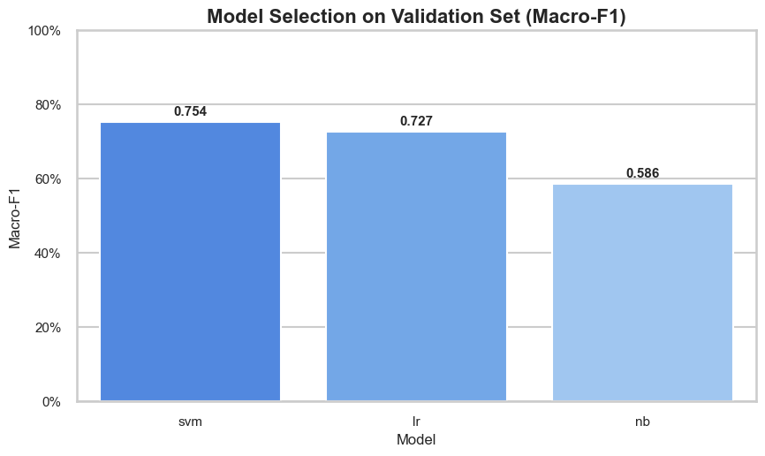
Business Intelligence

Slide 12
01
Problem Motivation & Objective
02
Data & Processing Setup
CONTENT OF PRESENTATION
03
Technical Design and Methodology
04
Results & Decision Value
05
Conclusion + Limitations + Future Work

Slide 13
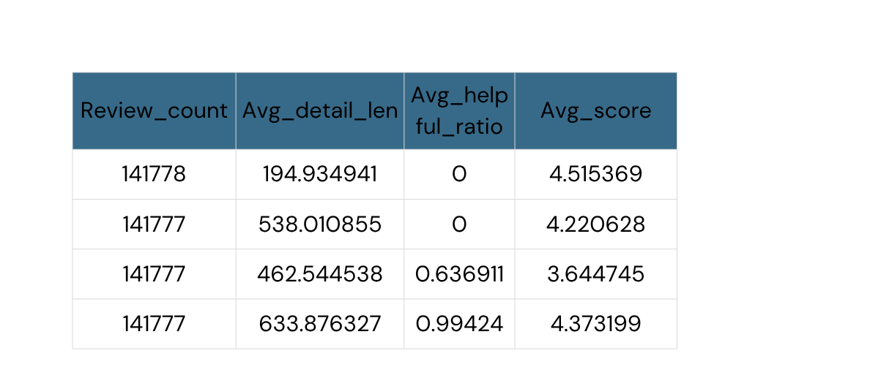
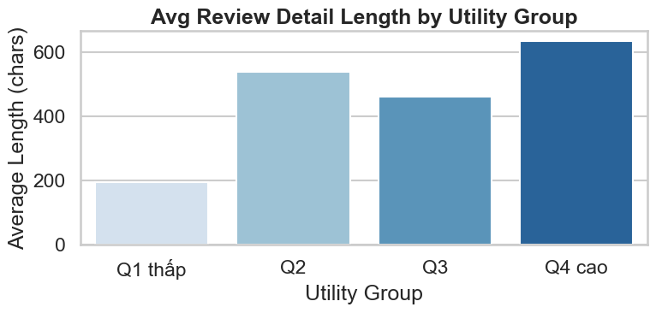

INSIGHT 1: DISPLAY ALGORITHM OPTIMIZATION
Prioritize Length: Configure the algorithm to automatically boost reviews with over 600 characters to top-of-page priority.
Prioritize Multimedia: Highlight reviews featuring images and videos, as these correlate with the highest utility and helpfulness for potential buyers.

Slide 14
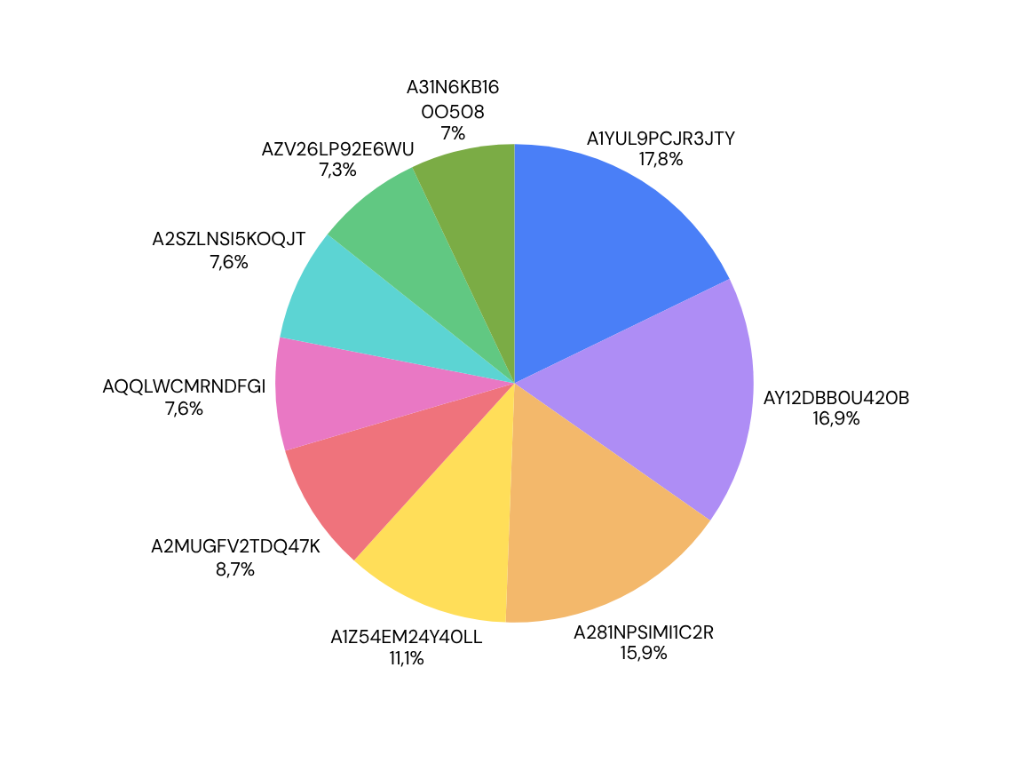

INSIGHT 2: LOYALTY MARKETING STRATEGY
Reward Power Users: Identify customers with the highest (100+) reviews for exclusive vouchers.
Expert Programs: Invite top contributors to join professional "Expert Reviewer" programs.
User ID Tracking: Utilize User ID data to accurately track activity levels and identify the most valuable brand advocates.

Slide 15
INSIGHT 3: PRODUCT QUALITY EARLY WARNING
Product | Time | total_reviews | lowreviews | low-rate | warning_months
B006N3I69A | 2011-02 | 22 | 22 | 1.0 | 3
B006N3I69A | 2011-03 | 12 | 12 | 1.0 | 3
B000X1Q1G8 | 2012-07 | 10 | 10 | 1.0 | 3
B004H3N2LU | 2011-01 | 18 | 17 | 0.944 | -
B001M08YZA | 2012-09 | 16 | 15 | 0.937 | -
B006N3I69A | 2011-01 | 31 | 29 | 0.935 | 3
B004OAZ36I | 2012-10 | 14 | 13 | 0.928 | 2
B0083T5TAQ | 2012-10 | 14 | 13 | 0.928 | 2
B000084ETV | 2008-08 | 12 | 11 | 0.916 | -
B0009XQWDM | 2008-08 | 12 | 11 | 0.916 | -
Automated Ad Suppression: Automatically pause marketing spend and internal promotions for products that trigger a "Red Flag" status (e.g., >91% low-star rate) to protect brand reputation.

Slide 16
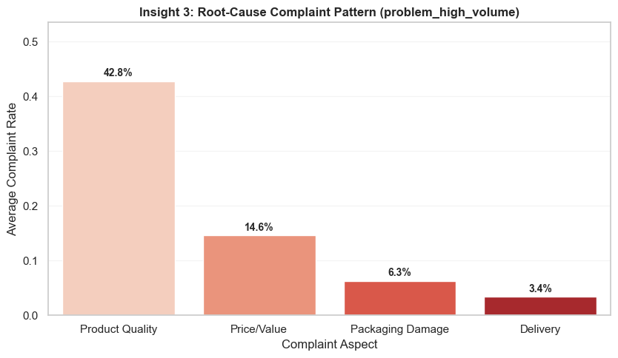
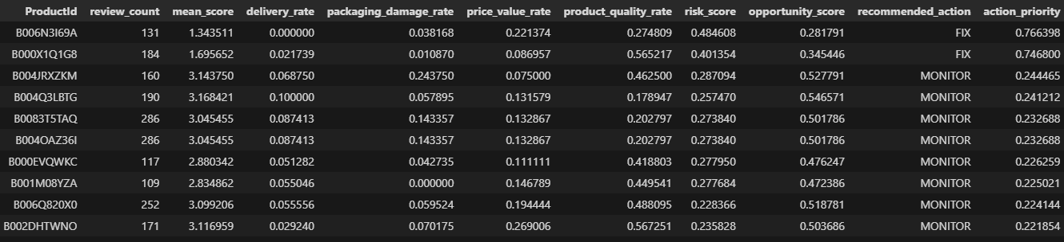
INSIGHT 4: COMPLAINT ROOT-CAUSE PRIORITIZATION
Recommended Action
Quality Assurance: Conduct supplier audits to address the 42.8% quality failure rate.
Design & Ops: Review product redesigns and tighten QC checkpoints at all stages.
Inventory: Replace poor-performing SKUs marked as "FIX" in the risk matrix.

Slide 17
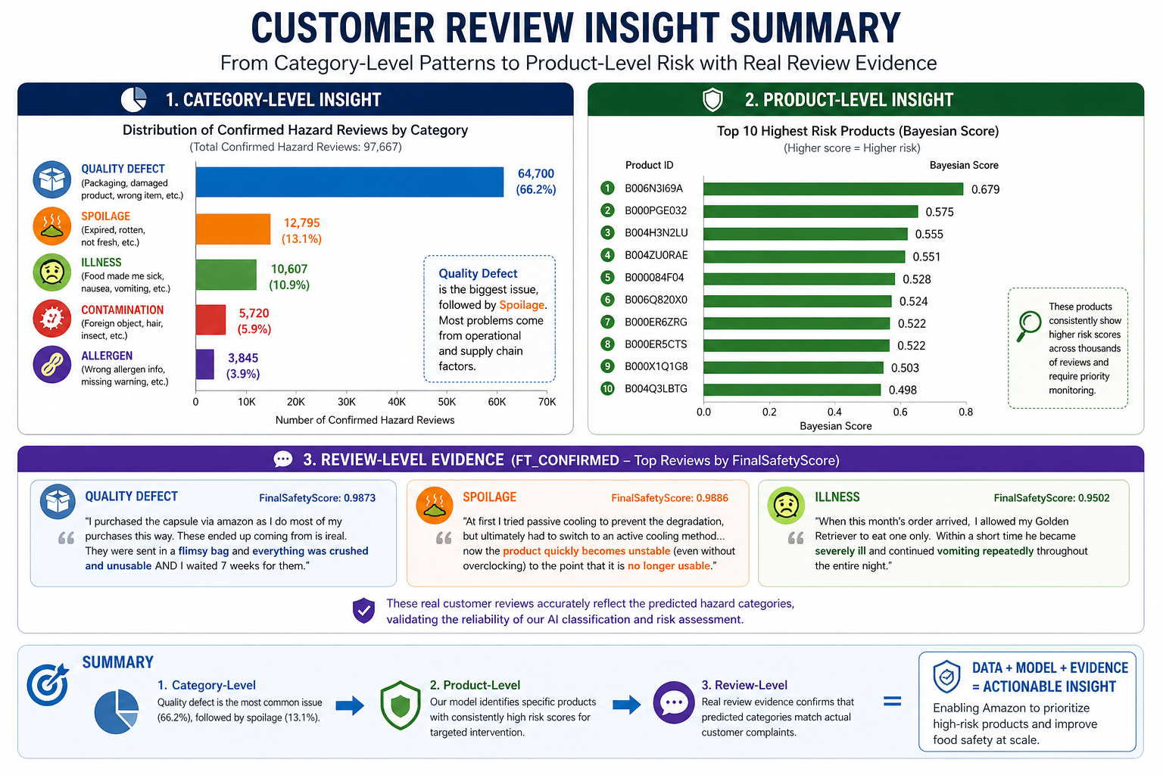
INSIGHT 5: FOOD SAFETY INTELLIGENCE
Automation
Decision System
Daily: Detect new hazards
Weekly: Review medium/high-risk products
Monthly: Trend analysis & updates
Low Risk → No Action
Medium Risk → Monitor
High Risk → Investigate
Remove Product
Shadow Ban (Not showing on the recommender system except have the link)
Flag Seller (Show popup when user get in the product detail page)

Slide 18
01
Problem & Motivation
02
Data & Processing Setup
CONTENT OF PRESENTATION
03
Technical Design and Methodology & Scoring
04
Results & Decision Value
05
Conclusion + Limitations + Future Work

Slide 19
Conclusion + Limitations + Future Work
Conclusion
Using Mongodb and processing dataset with NLP
Food Safety Intelligence : Detected hidden risks using Fine-tuned MiniLM and DeBERTa pipeline
Business Intelligence : Generated measurable business value
Limitations
User-generated reviews may contain noise / bias / fake signals
No direct linkage with sales, refund, or ERP data
Buiness Intellegence’s sentiment labels are proxy labels from score
Future work
Expand minority hazard class data
Multi-label hazard classification
Replace sentiment proxy with manually labeled sentiment data or stronger transformer models

Slide 20
REFERENCES
https://ieeexplore.ieee.org/stamp/stamp.jsp?tp=&arnumber=9716410
https://www.mdpi.com/2079-9292/13/7/1305
https://ieeexplore.ieee.org/stamp/stamp.jsp?arnumber=8376299
https://aclanthology.org/W02-1011/
https://www.kaggle.com/datasets/snap/amazon-fine-food-reviews?select=Reviews.csv

Slide 21

TESTIMONIALS
THANK YOU
Murad Naser
Client
Client

